Slide 1
School of Computing Science and Engineering
Course Code: BTCS9401
Course Name: Data Science
UNIT -1
Faculty Name: Mr. S. Prakash
Program Name: B.Tech

Slide 2
COURSE OBJECTIVE
Understand concepts of data science.
Understand popular tools of data analysis.
Learn data science in python.
Apply different visualization Techniques on datasets.
Implement learning techniques in data science.

Slide 3
Python Installation steps for data science.
Install Anaconda
Open Jupyter Notebook
Start New Notebook
Try Math Calculations
Import Data Science Libraries
https://elitedatascience.com/python-quickstart

Slide 4
Install Anaconda
We strongly recommend installing the Anaconda Distribution, which includes Python, Jupyter Notebook (a lightweight IDE very popular among data scientists), and all the major libraries.
It’s the closest thing to a one-stop-shop for all your setup needs.
Simply download Anaconda with the latest version of Python 3 and follow the wizard:

Slide 5
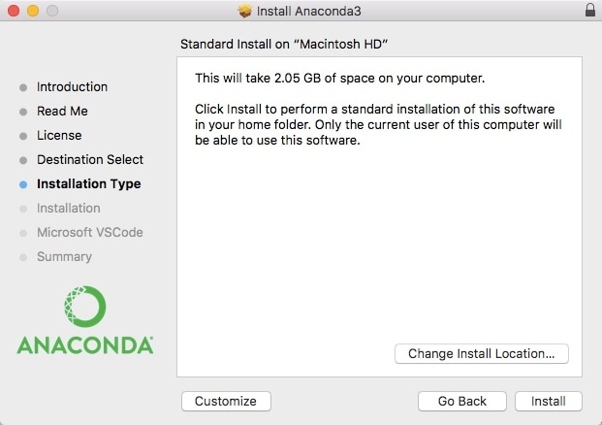
Install Anaconda

Slide 6
Open Jupyter Notebook
Jupyter Notebook is our favorite IDE (integrated development environment) for data science in Python. An IDE is just a fancy name for an advanced text editor for coding.
(As an analogy, think of Excel as an “IDE for spreadsheets.” For example, it has tabs, plugins, keyboard shortcuts, and other useful extras.)

Slide 7
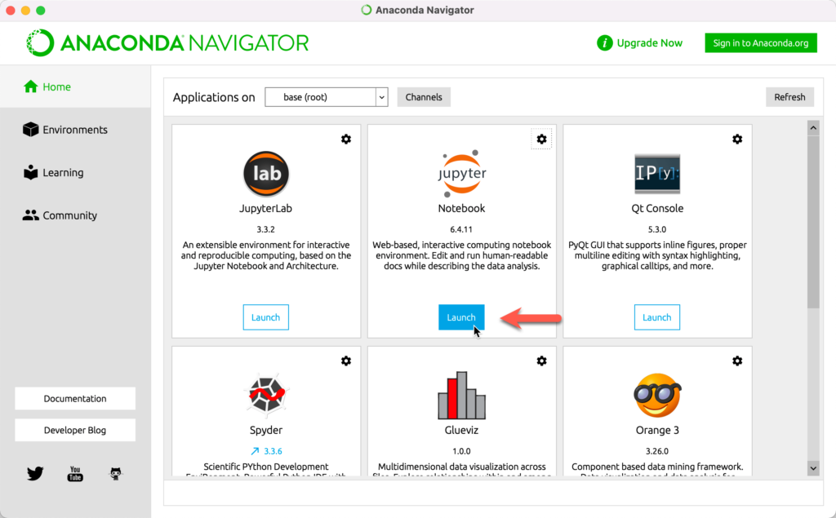
Open Jupyter Notebook

Slide 8
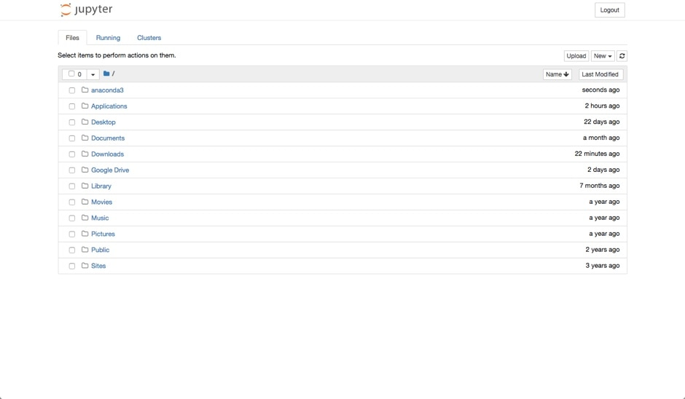
Open Jupyter Notebook

Slide 9
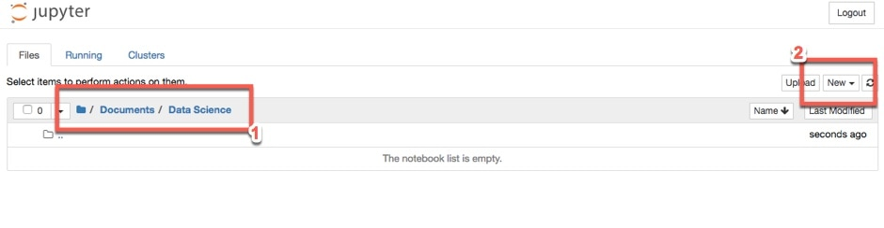
Open New Notebook

Slide 10
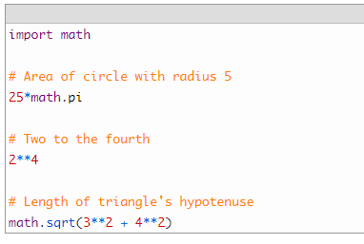
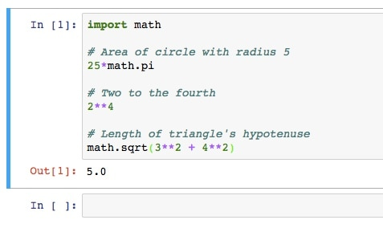
Try Math Calculations

Slide 11
Import Data Science Libraries
First, we imported the Pandas library. We also gave it the alias of pd. This means we can evoke the library with pd. You’ll see this in action shortly.
Next, we imported the pyplot module from the matplotlib library. Matplotlib is the main plotting library for Python. There’s no need to bring in the entire library, so we just imported a single module. Again, we gave it an alias of plt.
The %matplotlib inline command? That’s Jupyter Notebook specific. It simply tells the notebook to display our plots inside the notebook, instead of in a separate screen.
Finally we imported a basic linear regression algorithm from scikit-learn. Scikit-learn has a buffet of algorithms to choose from. At the end of this guide, we’ll point you to a few resources for learning more about these algorithms.

Slide 12
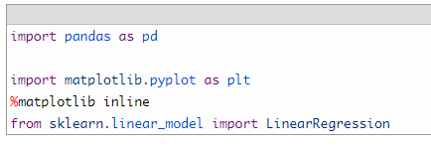
Import Data Science Libraries

Slide 13
Galgotias University
THANK YOU
THANK YOU

